Slide 1
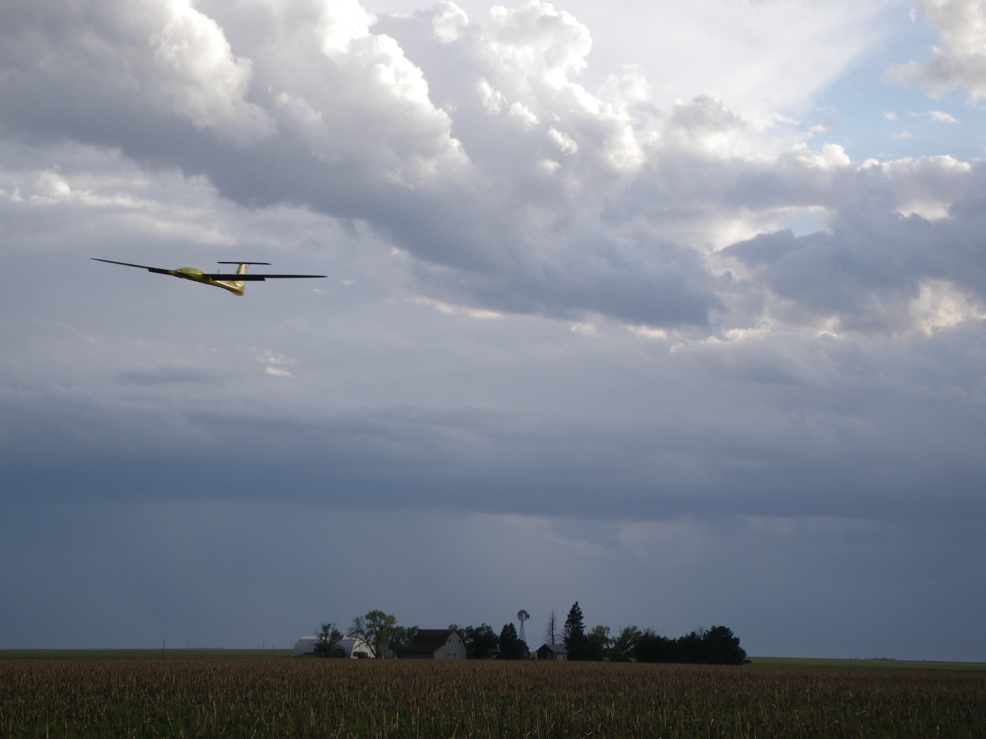
Chapter 13
Vision Based Guidance

Slide 2
Architecture w/ Camera

Slide 3
Gimbal and Camera Reference Frames
Notes:
\noindent
Gimbal-1 frame:
$\mathcal{F}^{g1}=(\mathbf{i}^{g1}, \mathbf{j}^{g1}, \mathbf{k}^{g1})$
\noindent
Gimbal frame: $\mathcal{F}^g=(\mathbf{i}^{g}, \mathbf{j}^{g},
\mathbf{k}^{g})$
\noindent
Camera frame:
$\mathcal{F}^c=(\mathbf{i}^{c}, \mathbf{j}^{c}, \mathbf{k}^{c})$
\vspace{0.5cm}
\noindent
Gimbal-1 frame: \\
Rotate body frame about $\kbf^b$ axis \\
by gimbal azimuth angle, $\alpha_{\text{az}}$
\[
\mathcal{R}_b^{g1}(\alpha_{\text{az}}) \defeq \begin{pmatrix}
\cos\alpha_{\text{az}} & \sin\alpha_{\text{az}} & 0 \\
-\sin\alpha_{\text{az}} & \cos\alpha_{\text{az}} & 0 \\
0 & 0 & 1
\end{pmatrix}
\]

Slide 4
Gimbal Reference Frames
Notes:
\noindent
Gimbal frame: \\
Rotate gimbal-1 frame about $\jbf^{g1}$ axis \\
by gimbal elevation angle, $\alpha_{\text{el}}$
\begin{align*}
\mathcal{R}_{g1}^{g}(\alpha_{\text{el}}) &\defeq
\begin{pmatrix}
\cos\alpha_{\text{el}} & 0 & -\sin\alpha_{\text{el}} \\
0 & 1 & 0 \\
\sin\alpha_{\text{el}} & 0 & \cos\alpha_{\text{el}}
\end{pmatrix}
\\
\mathcal{R}_b^g = \mathcal{R}_{g1}^{g} \mathcal{R}_b^{g1} &= \begin{pmatrix} %
\cos\alpha_{\text{el}}\cos\alpha_{\text{az}} & %
\cos\alpha_{\text{el}}\sin\alpha_{\text{az}} & %
-\sin\alpha_{\text{el}} \\
-\sin\alpha_{\text{az}} & %
\cos\alpha_{\text{az}} & %
0 \\
\sin\alpha_{\text{el}}\cos\alpha_{\text{az}} & %
\sin\alpha_{\text{el}}\sin\alpha_{\text{az}} & %
\cos\alpha_{\text{el}}
\end{pmatrix}
\end{align*}

Slide 5
Camera Reference Frame
Notes:
\noindent
Camera frame: \\
$\mathbf{i}^c$ points to the right in the image \\
$\mathbf{j}^c$ points down in the image \\
$\mathbf{k}^c$ points along the optical axis
\[
\mathcal{R}_g^c = \begin{pmatrix}
0 & 1 & 0 \\
0 & 0 & 1 \\
1 & 0 & 0
\end{pmatrix}
\]

Slide 6
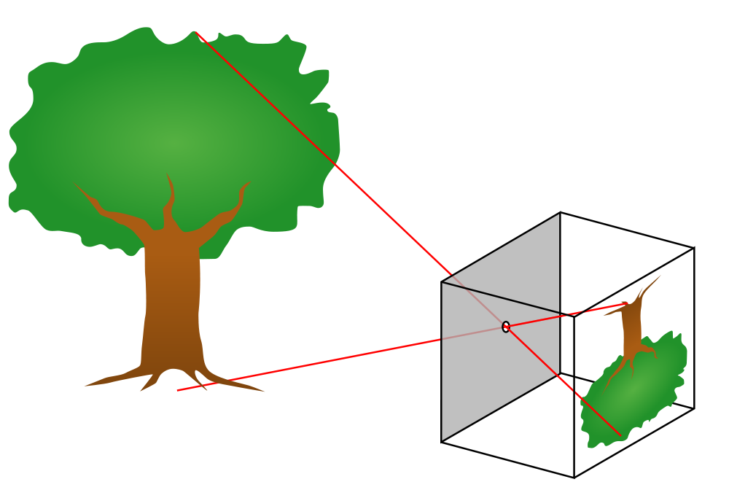
Pinhole Camera Model
Describes mathematical relationship between coordinates of 3-D point and its projection onto 2-D image plane
Assumes point aperture, no lenses
Good 1st order approximation

Slide 7
Pinhole Camera Model
image plane
Notes:
\noindent
{\bf Goal:} \\
From pixel location $(\epsilon_x, \epsilon_y)$ in image plane and camera \\ parameters, determine location of object in world $\boldsymbol{\ell}^c$
\vspace{1cm}
\noindent
{\bf Approach:} \\
Use similar triangles geometry

Slide 8
Camera Model
image plane
Notes:
\noindent
$f$: focal length in pixels \\
$P$: converts pixels to meters \\
$M$: width of square pixel array \\
$v$: field of view \\
$\boldsymbol{\ell}^c$: 3-D location of point
\[
f = \frac{M}{2\tan\left(\frac{\upsilon}{2}\right)}
\]
\vspace{0.5cm}
\noindent
Location of projection of object in camera frame: $(P\epsilon_x, P\epsilon_y, Pf)$\\
Pixel location (in pixels): $\epsilon_x$, $\epsilon_y$
\vspace{0.5cm}
\noindent
Distance from origin of camera frame to object image: \\
$F = \sqrt{f^2 + \epsilon_x^2 + \epsilon_y^2}$

Slide 9
Camera Model
image plane
Notes:
\noindent
By similar triangles:
\[
\frac{\ell_x^c}{\mathbb{L}} = \frac{P\epsilon_x}{PF} = \frac{\epsilon_x}{F}
\]
\vspace{0.5cm}
\noindent
Similarly:
\[\ell_y^c/\mathbb{L} = \epsilon_y/F \quad \text{ and } \quad \ell_z^c/\mathbb{L} =
f/F
\]
\vspace{0.5cm}
\noindent
Combining:
\[
\boldsymbol{\ell}^c = \begin{pmatrix} \ell^c_x \\
\ell^c_y \\ \ell^c_z \end{pmatrix}
=\frac{\mathbb{L}}{F} \begin{pmatrix} \epsilon_x \\
\epsilon_y
\\ f \end{pmatrix}
\]
\vspace{0.5cm}
\[
\boxed{
\text{{\bf Problem:} $\mathbb{L}$ is unknown...}
}
\]

Slide 10
Camera Model
image plane
Notes:
\noindent
Unit direction vector to target:
\begin{equation*}
\frac{\boldsymbol{\ell}^c}{\mathbb{L}} = \frac{1}{F}
\begin{pmatrix} \epsilon_x \\ \epsilon_y \\ f \end{pmatrix}
= \frac{1}{\sqrt{\epsilon_x^2+\epsilon_y^2+f^2}}
\begin{pmatrix} \epsilon_x \\ \epsilon_y \\ f \end{pmatrix}
\end{equation*}
\vspace{0.5cm}
\noindent
Define notation:
\[
\check{\boldsymbol{\ell}} \defeq \begin{pmatrix} \check{\ell}_x \\ \check{\ell}_y
\\ \check{\ell}_z \end{pmatrix} \defeq \frac{\boldsymbol{\ell}}{\mathbb{L}}
\]

Slide 11
Gimbal Pointing
Two scenarios
Point gimbal at given world coordinate
“Point to this GPS location”
Point gimbal so that optical axis aligns with certain point in image plane
“Point at this object”
Gimbal dynamics
Assume rate control inputs
Notes:
\dot{\alpha}_{\text{az}} &= u_{\text{az}} \\
\dot{\alpha}_{\text{el}} &= u_{\text{el}}

Slide 12
Scenario 1: Point Gimbal at World Coordinate
Notes:
\noindent
$\mathbf{p}_{\text{obj}}^i$: known location of
object in inertial frame (world coordinate) \\
$\mathbf{p}_{\text{MAV}}^i=(p_n, p_e, p_d)^{\top}$: location of
MAV in inertial frame
\vspace{0.5cm}
\noindent
{\bf Objective:} \\
Align optical axis of camera with desired relative position vector
\[
\boldsymbol{\ell}^i_d \defeq \mathbf{p}_{\text{obj}}^i-\mathbf{p}_{\text{MAV}}^i
\]
\vspace{0.5cm}
\noindent
Body-frame unit vector that points in desired direction of specified \\ world coordinates
\[
\check{\boldsymbol{\ell}}^b_d = \frac{1}{\norm{\boldsymbol{\ell}^i_d}}\mathcal{R}_i^b \, {\boldsymbol{\ell}^i_d}
\]

Slide 13
Scenario 2: Point Gimbal at Object in Image
Notes:
\noindent
{\bf Objective:} \\
Maneuver gimbal so that object at pixel location $\epsilon$ is pushed to center of image
\vspace{0.5cm}
\noindent Desired direction of optical axis:
\[
\check{\boldsymbol{\ell}}^c_d = \frac{1}{\sqrt{f^2+\epsilon_x^2+\epsilon_y^2}}
\begin{pmatrix} \epsilon_x \\ \epsilon_y \\ f \end{pmatrix}
\]
\vspace{0.5cm}
\noindent Desired direction of optical axis expressed in body frame:
\[
\check{\boldsymbol{\ell}}^b_d = \mathcal{R}_g^b \mathcal{R}_c^g \, \check{\boldsymbol{\ell}}^c_d
\]

Slide 14
Gimbal Pointing Angles
Notes:
\noindent We know direction to point gimbal
\vspace{0.5cm}
\noindent What are corresponding azimuth and elevation angles?
\vspace{0.5cm}
\noindent
Optical axis in camera frame = $(0, 0, 1)^\top$
\vspace{0.5cm}
\noindent
{\bf Objective:}
Select commanded gimbal angles
$\alpha_{\text{az}}^c$ and $\alpha_{\text{el}}^c$ so that
\begin{align*}
\check{\boldsymbol{\ell}}^{b}_d &\defeq \begin{pmatrix} \check{\ell}_{xd}^{b} \\ \check{\ell}_{yd}^{b} \\
\check{\ell}_{zd}^{b} \end{pmatrix}
= \mathcal{R}_g^b({\alpha_{\text{az}}^c},{\alpha_{\text{el}}^c}) \mathcal{R}_c^g \begin{pmatrix} 0 \\ 0 \\ 1
\end{pmatrix} \\
&= \begin{pmatrix}
\cos{\alpha_{\text{el}}^c} \cos{\alpha_{\text{az}}^c} &
-\sin{\alpha_{\text{el}}^c} &
-\sin{\alpha_{\text{el}}^c} \cos{\alpha_{\text{az}}^c} \\
\cos{\alpha_{\text{el}}^c} \sin{\alpha_{\text{az}}^c} &
\cos{\alpha_{\text{az}}^c} &
-\sin{\alpha_{\text{el}}^c} \sin{\alpha_{\text{az}}^c} \\
\sin{\alpha_{\text{el}}^c} &
0 &
\cos{\alpha_{\text{el}}^c}
\end{pmatrix}
\begin{pmatrix}
0 & 0 & 1 \\
1 & 0 & 0 \\
0 & 1 & 0
\end{pmatrix}
\begin{pmatrix}
0 \\
0 \\
1
\end{pmatrix} \\
&= \begin{pmatrix}
\cos{\alpha_{\text{el}}^c} \cos{\alpha_{\text{az}}^c} \\
\cos{\alpha_{\text{el}}^c} \sin{\alpha_{\text{az}}^c} \\
\sin{\alpha_{\text{el}}^c}
\end{pmatrix}
\end{align*}

Slide 15
Gimbal Pointing Angles
Notes:
\noindent
{\bf Objective:}
Select commanded gimbal angles gimbal angles
$\alpha_{\text{az}}^c$ and $\alpha_{\text{el}}^c$ so that
\begin{align*}
\begin{pmatrix} \check{\ell}_{xd}^{b} \\ \check{\ell}_{yd}^{b} \\
\check{\ell}_{zd}^{b} \end{pmatrix} &=
\begin{pmatrix}
\cos{\alpha_{\text{el}}^c} \cos{\alpha_{\text{az}}^c} \\
\cos{\alpha_{\text{el}}^c} \sin{\alpha_{\text{az}}^c} \\
\sin{\alpha_{\text{el}}^c}
\end{pmatrix}
\end{align*}
\noindent
Solving for $\alpha_{\text{el}}^c$ and $\alpha_{\text{az}}^c$ gives desired azimuth and elevation angles:
\begin{align*}
\alpha_{\text{az}}^c &=
\tan^{-1}\left(\frac{\check{\ell}_{yd}^b}{\check{\ell}_{xd}^b}\right) \\
\alpha_{\text{el}}^c &= \sin^{-1} \left( \check{\ell}_{zd}^b \right)
\end{align*}
Gimbal servo commands can be selected as:
\begin{align*}
u_{\text{az}} &= k_{\text{az}} ({\alpha_{\text{az}}^c} - \alpha_{\text{az}}) \\
u_{\text{el}} &= k_{\text{el}} ({\alpha_{\text{el}}^c} - \alpha_{\text{el}})
\end{align*}
$k_{\text{az}}$ and $k_{\text{el}}$ are positive control gains

Slide 16
Geolocation
Notes:
\noindent
Relative position vector between target and MAV:
$\boldsymbol{\ell} =
\mathbf{p}_{\text{obj}}-\mathbf{p}_{\text{MAV}}$
\vspace{0.5cm}
\noindent Define:
\begin{align*}
\mathbb{L}&=\norm{\boldsymbol{\ell}} \text{~(range to target)} \\
\check{\boldsymbol{\ell}}&=\boldsymbol{\ell}/\mathbb{L} \text{~(unit vector pointing from aircraft to target)}
\end{align*}
\vspace{0.5cm}
\noindent
From geometry:
\begin{align*}
\mathbf{p}_{\text{obj}}^i &= \mathbf{p}_{\text{MAV}}^i + \mathcal{R}_b^i \mathcal{R}_g^b \mathcal{R}_c^g \boldsymbol{\ell}^c \\
&= \mathbf{p}_{\text{MAV}}^i + \mathbb{L} \left(\mathcal{R}_b^i \mathcal{R}_g^b \mathcal{R}_c^g \check{\boldsymbol{\ell}}^c\right)
\end{align*}
where
\begin{align*}
\mathbf{p}_{\text{MAV}}^i &= (p_n, p_e, p_d)^{\top} \\
\mathcal{R}_b^i &= \mathcal{R}_b^i(\phi,\theta,\psi) \\
\mathcal{R}_g^b &= \mathcal{R}_g^b(\alpha_{\text{az}},\alpha_{\text{el}})
\end{align*}
\noindent
\[
\boxed{ \text{
$\mathbb{L}$ is unknown $\rightarrow$ solving geolocation problem reduces
to estimating range to target $\mathbb{L}$}}
\]

Slide 17
Range to Target – Flat Earth Model
Notes:
\begin{align*}
\text{From geometry:} & \quad \cos\varphi = \frac{h}{\mathbb{L}} \\
\text{From Cauchy-Schwartz equality:} & \quad
\cos\varphi = \mathbf{k}^i \cdot \check{\boldsymbol{\ell}}^i = \mathbf{k}^i \cdot \mathcal{R}_b^i \mathcal{R}_g^b \mathcal{R}_c^g \check{\boldsymbol{\ell}}^c \\
\text{Equating:} & \quad
\mathbb{L} = \frac{h}{\mathbf{k}^i \cdot \mathcal{R}_b^i \mathcal{R}_g^b \mathcal{R}_c^g \check{\boldsymbol{\ell}}^c} \\
\text{From before:} & \quad
\mathbf{p}_{\text{obj}}^i = \mathbf{p}_{\text{MAV}}^i + \mathbb{L} \left(\mathcal{R}_b^i \mathcal{R}_g^b \mathcal{R}_c^g \check{\boldsymbol{\ell}}^c\right)
\\
\text{Therefore:} & \quad
\boxed{
\mathbf{p}_{\text{obj}}^i = \begin{pmatrix} p_n \\ p_e \\ p_d \end{pmatrix} + h
\frac{\mathcal{R}_b^i \mathcal{R}_g^b \mathcal{R}_c^g \check{\boldsymbol{\ell}}^c}{\mathbf{k}^i \cdot \mathcal{R}_b^i \mathcal{R}_g^b
\mathcal{R}_c^g \check{\boldsymbol{\ell}}^c}
}
\end{align*}

Slide 18
Geolocation Errors
Notes:
The position of the object is
\[
\mathbf{p}_{\text{obj}}^i = \begin{pmatrix} p_n \\ p_e \\ p_d \end{pmatrix} + h
\frac{\mathcal{R}_b^i \mathcal{R}_g^b \mathcal{R}_c^g \check{\boldsymbol{\ell}}^c}{\mathbf{k}^i \cdot \mathcal{R}_b^i \mathcal{R}_g^b
\mathcal{R}_c^g \check{\boldsymbol{\ell}}^c}
\]
\vspace{0.5cm}
\noindent
Equation is highly sensitive to measurement errors
\begin{itemize}
\item attitude estimation errors
\item gimbal pointing angle errors
\item gimbal/autopilot alignment errors
\end{itemize}
\vspace{0.5cm}
\noindent
Two types of errors
\begin{itemize}
\item bias errors (address with calibration)
\item random errors (address with EKF)
\end{itemize}

Slide 19
Geolocation Using EKF
Notes:
\noindent The states are $x=(\mathbf{p}_{\text{obj}}^{i^{\top}}, \;\; \mathbb{L})^{\top}$. Need propagation equations $\dot{x} = f(x,u)$.
\noindent Assuming the object is stationary: \qquad $\dot{\mathbf{p}}_{\text{obj}}^i = 0$
\noindent Also:
\begin{align*}
\dot{\mathbb{L}} &= \frac{d}{dt}\sqrt{(\mathbf{p}_{\text{obj}}^i-\mathbf{p}_{\text{MAV}}^i)^{\top}(\mathbf{p}_{\text{obj}}^i-\mathbf{p}_{\text{MAV}}^i) } \\
&= \frac{(\mathbf{p}_{\text{obj}}^i-\mathbf{p}_{\text{MAV}}^i)^{\top}(\dot{\mathbf{p}}_{\text{obj}}^i-\dot{\mathbf{p}}_{\text{MAV}}^i)}{\mathbb{L}} \\
&= -\frac{(\mathbf{p}_{\text{obj}}^i-\mathbf{p}_{\text{MAV}}^i)^{\top}\dot{\mathbf{p}}_{\text{MAV}}^i}{\mathbb{L}}
\end{align*}
where
\[
\mathbf{p}_{\text{MAV}}^i = \mathbf{p}_{\text{obj}}^i - \mathbb{L} \left(\mathcal{R}_b^i \mathcal{R}_g^b \mathcal{R}_c^g \check{\boldsymbol{\ell}}^c\right)
\]
and for constant-altitude flight:
\[
\dot{\mathbf{p}}_{\text{MAV}}^i = \begin{pmatrix} \hat{V}_g \cos\hat{\chi} \\ \hat{V}_g \sin\hat{\chi} \\ 0 \end{pmatrix}
\]

Slide 20
Geolocation Using EKF
Notes:
\begin{align*}
\text{Prediction equations:} &\qquad
\begin{pmatrix} \dot{\hat{\mathbf{p}}}_{\text{obj}}^i \\ \dot{\hat{\mathbb{L}}} \end{pmatrix} = \begin{pmatrix} 0 \\ -\frac{(\hat{\mathbf{p}}_{\text{obj}}^i-\hat{\mathbf{p}}_{\text{MAV}}^i)^{\top}\dot{\hat{\mathbf{p}}}_{\text{MAV}}^i}
{\hat{\mathbb{L}}} \end{pmatrix}
\\ \\
\text{Jacobian of prediction equation:} &\qquad
\frac{\partial f}{\partial x} = \begin{pmatrix} 0 & 0 \\ -\frac{\dot{\hat{\mathbf{p}}}_{\text{MAV}}^{iT}}{\hat{\mathbb{L}}} & \frac{(\hat{\mathbf{p}}_{\text{obj}}^i-\hat{\mathbf{p}}_{\text{MAV}}^i)^{\top}\dot{\hat{\mathbf{p}}}_{\text{MAV}}}{\hat{\mathbb{L}}^2} \end{pmatrix}
\\ \\
\text{Measurement equation:} &\qquad
\mathbf{p}_{\text{MAV}}^i = \mathbf{p}_{\text{obj}}^i - \mathbb{L} \left(\mathcal{R}_b^i \mathcal{R}_g^b \mathcal{R}_c^g \check{\boldsymbol{\ell}}^c\right)
\\ \\
\text{Jacobian of measurement equation:} &\qquad
\frac{\partial h}{\partial x} = \begin{pmatrix} I & \mathcal{R}_b^i \mathcal{R}_g^b \mathcal{R}_c^g \check{\boldsymbol{\ell}}^c \end{pmatrix}
\end{align*}

Slide 21
Geolocation Architecture
GPS smoother
vision processing
geo-location
attitude estimation
gimbal

Slide 22
Target Motion in Image Plane
Notes:
\begin{itemize}
\item The objective is to track targets seen in the image plane.
\item Feature tracking, or other computer vision algorithms, are used to track pixels in image plane.
\item Feature tracking is noisy, and so pixel location must be low pass filtered.
\item Motion of the target in the image plane is due to two sources:
\begin{itemize}
\item Self motion, or ego motion. Primarily due to rotation of the MAV.
\item Relative target motion.
\end{itemize}
\item Since we are primarily interested in the relative motion, we must subtract the pixel movement due to ego motion.
\end{itemize}

Slide 23
Pixel LPF and Differentiation
Notes:
Define the following
\begin{align*}
\bar{\boldsymbol{\epsilon}} = (\bar{\epsilon}_x, \bar{\epsilon}_y)^{\top}, &
\text{~~~Raw pixel measurements,} \\
\boldsymbol{\epsilon} = (\epsilon_x, \epsilon_y)^{\top}, &
\text{~~~Filtered pixel location,} \\
\dot{\boldsymbol{\epsilon}} = (\dot{\epsilon}_x, \dot{\epsilon}_y)^{\top}, &
\text{~~~Filtered pixel velocity}
\end{align*}
Basic idea: LPF $\bar{\boldsymbol{\epsilon}}$ to obtain $\boldsymbol{\epsilon}$, and use dirty derivative to obtain $\dot{\boldsymbol{\epsilon}}$:
\[
\boldsymbol{\epsilon}(s) = \frac{1}{\tau s + 1} \bar{\boldsymbol{\epsilon}},
\qquad\qquad
\dot{\boldsymbol{\epsilon}}(s) = \frac{s}{\tau s + 1}\bar{\boldsymbol{\epsilon}}.
\]

Slide 24
Digital Approximation
Notes:
\[
\text{Tustin approximation} \qquad\qquad
s\mapsto \frac{2}{T_s}\frac{z-1}{z+1} ,
\]
Converting to the $z$-domain gives
\begin{align*}
\boldsymbol{\epsilon}[z] &= \frac{1}{\frac{2\tau}{T_s}\frac{z-1}{z+1}+1} \bar{\boldsymbol{\epsilon}}
= \frac{\frac{T_s}{2\tau+T_s}(z+1)}{z-\frac{2\tau-T_s}{2\tau+T_s}}\bar{\boldsymbol{\epsilon}} \\
\dot{\boldsymbol{\epsilon}}[z] &= \frac{\frac{2}{T_s}\frac{z-1}{z+1}}{\frac{2\tau}{T_s}\frac{z-1}{z+1}+1} \bar{\boldsymbol{\epsilon}}
= \frac{\frac{2}{2\tau+T_s}(z-1)}{z-\frac{2\tau-T_s}{2\tau+T_s}}\bar{\boldsymbol{\epsilon}}.
\end{align*}
Taking the inverse $z$-transform gives the difference equations
\begin{align*}
\boldsymbol{\epsilon}[n] &= \left(\frac{2\tau-T_s}{2\tau+T_s}\right)\boldsymbol{\epsilon}[n-1] + \left(\frac{T_s}{2\tau+T_s}\right)\left(\bar{\boldsymbol{\epsilon}}[n]+\bar{\boldsymbol{\epsilon}}[n-1]\right) \\
\dot{\boldsymbol{\epsilon}}[n] &= \left(\frac{2\tau-T_s}{2\tau+T_s}\right)\dot{\boldsymbol{\epsilon}}[n-1] + \left(\frac{2}{2\tau+T_s}\right)\left(\bar{\boldsymbol{\epsilon}}[n]-\bar{\boldsymbol{\epsilon}}[n-1]\right), \end{align*}
where $\boldsymbol{\epsilon}[0] = \bar{\boldsymbol{\epsilon}}[0]$
and $\dot{\boldsymbol{\epsilon}}[0] = 0$.

Slide 25
Digital Approximation
Notes:
\noindent Define $\beta = (2\tau-T_s)/(2\tau+T_s)$,
and note that $1-\beta = 2T_s/(2\tau+T_s)$. Then
\begin{align*}
\boldsymbol{\epsilon}[n] &= \beta \, \boldsymbol{\epsilon}[n-1] + \left(1-\beta\right)\underbrace{\left(\frac{\bar{\boldsymbol{\epsilon}}[n]+\bar{\boldsymbol{\epsilon}}[n-1]}{2}\right)}_{\text{Average of last two samples}} \\
\dot{\boldsymbol{\epsilon}}[n] &= \beta \, \dot{\boldsymbol{\epsilon}}[n-1] + (1-\beta)\underbrace{\left(\frac{\bar{\boldsymbol{\epsilon}}[n]-\bar{\boldsymbol{\epsilon}}[n-1]}{T_s}\right)}_{\text{Euler approximation of derivative}},
\end{align*}
where $\boldsymbol{\epsilon}[0] = \bar{\boldsymbol{\epsilon}}[0]$
and $\dot{\boldsymbol{\epsilon}}[0] = 0$.

Slide 26
Apparent Motion
Notes:
Let
$\check{\boldsymbol{\ell}} \defeq \boldsymbol{\ell}/\mathbb{L} = (\mathbf{p}_{\text{obj}}-\mathbf{p}_{\text{MAV}})/\norm{\mathbf{p}_{\text{obj}}-\mathbf{p}_{\text{MAV}}}$ be
the normalized relative position vector.
The Coriolis formula (expressed in camera frame) gives
\[
\frac{d\check{\boldsymbol{\ell}}^c}{dt_i} = \frac{d\check{\boldsymbol{\ell}}^c}{dt_c} +
\boldsymbol{\omega}_{c/i}^c\times\check{\boldsymbol{\ell}}^c.
\]

Slide 27
Apparent Motion, cont.
Notes:
Motion of target in image plane:
\begin{align*}
\frac{d\check{\boldsymbol{\ell}}^c}{dt_c} &= \frac{d}{dt_c}
\frac{\begin{pmatrix}\epsilon_x \\ \epsilon_y \\ f\end{pmatrix}}{F}%
= \frac{F\begin{pmatrix}\dot{\epsilon}_x \\ \dot{\epsilon}_y
\\ 0 \end{pmatrix} - \dot{F}\begin{pmatrix}\epsilon_x \\ \epsilon_y \\ f
\end{pmatrix}}{F^2}%
= \frac{F\begin{pmatrix}\dot{\epsilon}_x \\ \dot{\epsilon}_y
\\ 0 \end{pmatrix} - \frac{\epsilon_x\dot{\epsilon}_x + \epsilon_y\dot{\epsilon}_y}{F}
\begin{pmatrix}\epsilon_x \\ \epsilon_y \\ f
\end{pmatrix}}{F^2} \notag \\
&= \frac{1}{F^3}\begin{pmatrix} F^2-\epsilon_x^2 &
-\epsilon_x\epsilon_y \\ -\epsilon_x\epsilon_y & F^2 - \epsilon_y^2
\\ -\epsilon_xf & -\epsilon_yf \end{pmatrix} \begin{pmatrix}
\dot{\epsilon}_x \\ \dot{\epsilon}_y \end{pmatrix} %
= \frac{1}{F^3}\begin{pmatrix} \epsilon_y^2+f^2 &
-\epsilon_x\epsilon_y
\\ -\epsilon_x\epsilon_y & \epsilon_x^2+f^2
\\ -\epsilon_xf & -\epsilon_yf \end{pmatrix} \dot{\boldsymbol{\epsilon}} \notag \\
&= Z(\boldsymbol{\epsilon})\dot{\boldsymbol{\epsilon}},
\end{align*}
where
\[
Z(\boldsymbol{\epsilon}) \defeq \frac{1}{F^3}\begin{pmatrix} \epsilon_y^2+f^2 &
-\epsilon_x\epsilon_y
\\ -\epsilon_x\epsilon_y & \epsilon_x^2+f^2
\\ -\epsilon_xf & -\epsilon_yf \end{pmatrix} \dot{\boldsymbol{\epsilon}}.
\]

Slide 28
Apparent Motion, cont.
Notes:
Ego Motion, $\boldsymbol{\omega}_{c/i}^c \times \check{\boldsymbol{\ell}}^c$:
\[
\boldsymbol{\omega}_{c/i}^c = \underbrace{\boldsymbol{\omega}_{c/g}^c}_{0} + \underbrace{\boldsymbol{\omega}_{g/b}^c}_{\mathcal{R}_g^c\mathcal{R}_b^g\begin{pmatrix}
-\sin(\alpha_{\text{az}})\dot{\alpha}_{\text{el}} \\
\cos(\alpha_{\text{az}})\dot{\alpha}_{\text{el}} \\
\dot{\alpha}_{\text{az}}
\end{pmatrix}} + \underbrace{\boldsymbol{\omega}_{b/i}^c}_{\begin{pmatrix} p \\ q \\ r \end{pmatrix}}.
\]
Therefore
\[
\dot{\check{\boldsymbol{\ell}}}^c_{\text{app}} \defeq
\boldsymbol{\omega}_{c/i}^c \times \check{\boldsymbol{\ell}}^c
=
\frac{1}{F}
\left[ \mathcal{R}_g^c\mathcal{R}_b^g\begin{pmatrix}p
-\sin(\alpha_{\text{az}})\dot{\alpha}_{\text{el}}
\\ q + \cos(\alpha_{\text{az}})\dot{\alpha}_{\text{el}}
\\ r + \dot{\alpha}_{\text{az}} \end{pmatrix} \right] \times
\begin{pmatrix} \epsilon_x \\ \epsilon_y \\ f
\end{pmatrix}
\]

Slide 29
Total Motion in Image Plane
Notes:
\[
\frac{d\check{\boldsymbol{\ell}}^c}{dt_i} =
\underbrace{Z(\boldsymbol{\epsilon})\dot{\boldsymbol{\epsilon}}}_{\text{Target Motion}} +
\underbrace{\frac{1}{F}
\left[ \mathcal{R}_g^c\mathcal{R}_b^g\begin{pmatrix}p
-\sin(\alpha_{\text{az}})\dot{\alpha}_{\text{el}}
\\ q + \cos(\alpha_{\text{az}})\dot{\alpha}_{\text{el}}
\\ r + \dot{\alpha}_{\text{az}} \end{pmatrix} \right] \times
\begin{pmatrix} \epsilon_x \\ \epsilon_y \\ f
\end{pmatrix}}_{\text{Ego Motion}}
\]

Slide 30
Time to Collision
Notes:
For all objects in the camera field of view, it is possible to compute the time to collision to that obstacle, defined as:
\vspace{0.5cm}
\par\noindent{\bf The time to collision if the vehicle were to proceed along the line-of-sight vector to the obstacle at the current closing velocity.}
\vspace{0.5cm}
Therefore, for each obstacle, the time to collision is given by
\[
t_c \defeq -\frac{\mathbb{L}}{\dot{\mathbb{L}}}
\]
Impossible to compute using only a monocular camera because of scale ambiguity.
Two techniques:
\begin{itemize}
\item Looming $\leftarrow$ Requires target size.
\item Flat earth approximation $\leftarrow$ Requires height above ground.
\end{itemize}

Slide 31
Time to Collision - Looming
Notes:
From similar triangles:
\[
\frac{S_{\text{obj}}}{\mathbb{L}} = \frac{P\epsilon_s}{PF} = \frac{\epsilon_s}{F}
\]
If $S_{\text{obj}}$ is not changing, then
\begin{align*}
\frac{\dot{\mathbb{L}}}{\mathbb{L}} &=
\frac{\mathbb{L}}{S_{\text{obj}}}\left[\frac{\epsilon_s}{F}\frac{\dot{F}}{F}
- \frac{\dot{\epsilon}_s}{F} \right] \\
&= \frac{F}{\epsilon_s}\left[\frac{\epsilon_s}{F}\frac{\dot{F}}{F}
- \frac{\dot{\epsilon}_s}{F} \right] \\
&= \frac{\dot{F}}{F} - \frac{\dot{\epsilon}_s}{\epsilon_s} \notag \\
&=
\frac{\epsilon_x\dot{\epsilon}_x +
\epsilon_y\dot{\epsilon}_y}{F} -
\frac{\dot{\epsilon}_s}{\epsilon_s} ,
\end{align*}
the inverse of which is the time to collision $t_c$.

Slide 32
Time to Collision – Flat Earth
Notes:
\[
\mathbb{L}=\frac{h}{\cos\varphi}
\]
Differentiation gives
\begin{align*}
\frac{\dot{\mathbb{L}}}{\mathbb{L}} &= \frac{\dot{h}}{h} + \dot{\varphi}\tan\varphi.
\end{align*}
%
From geometry we have
\[
\cos\varphi = \check{\ell}^i_z.
\]
Differentiate and solve for $\dot{\varphi}$:
\[
\dot{\varphi} = -\frac{1}{\sin\varphi}\frac{d}{dt_i}\check{\ell}^i_z
\]
Therefore,
\[
\dot{\varphi}\tan\varphi = -\frac{1}{\cos\varphi} \frac{d}{dt_i} \check{\ell}^i_z =
-\frac{1}{\check{\ell}^i_z}\frac{d}{dt_i} \check{\ell}^i_z
\]

Slide 33
Precision Landing
Notes:
For precision landing, we use the guidance model
\begin{align*}
\dot{p}_n &= V_g\cos{\chi}\cos{\gamma} \\
\dot{p}_e &= V_g\sin{\chi}\cos{\gamma} \\
\dot{p}_d &= -V_g\sin{\gamma} \\
\dot{\chi} &= \frac{g}{V_g}\tan{\phi} \\
\dot{\phi} &= u_1 \\
\dot{\gamma} &= u_2.
\end{align*}
Define:
\begin{align*}
\mathbf{p}_{\text{MAV}}^i &= \begin{pmatrix} p_n, & p_e, & p_d \end{pmatrix}^{\top} \\
\mathbf{v}_{\text{MAV}}^i &= \begin{pmatrix}
V_g\cos\chi\cos\gamma, &
V_g\sin\chi\cos\gamma, &
-V_g\sin\gamma
\end{pmatrix}^{\top} \\
\mathbf{v}_{\text{MAV}}^{v_2} &= \begin{pmatrix} V_g, & 0, & 0 \end{pmatrix}^{\top}
\end{align*}

Slide 34
Proportional Navigation (PN)
Notes:
\noindent{\bf Proportional Navigation}: align the line-of-sight rate $\dot{\boldsymbol{\ell}}$ with the negative line-of-sight vector $-\boldsymbol{\ell}$.
Define
\[
\boldsymbol{\Omega}_{\perp} = \check{\boldsymbol{\ell}} \times \frac{\dot{\boldsymbol{\ell}}}{\mathbb{L}}.
\]
\noindent Assuming constant velocity, we can only accelerate in the plane perpendicular to the velocity vector. Therefore, to zero $\boldsymbol{\Omega}_{\perp}$, the desired acceleration is
\[
\mathbf{a}_{\text{MAV}} = N\boldsymbol{\Omega}_{\perp} \times \mathbf{v}_{\text{MAV}},
\]
where $N>0$ is the (tunable) navigation constant.

Slide 35
Acceleration Command
Notes:
To implement the acceleration command, must convert to vehicle-2 frame as
\begin{align*}
\mathbf{a}_{\text{MAV}}^{v2} &= \mu N\boldsymbol{\Omega}_{\perp}^{v2} \times \mathbf{v}_{\text{MAV}}^{v2} \notag \\
&= \mu N \begin{pmatrix} \Omega_{\perp,x}^{v2} \\
\Omega_{\perp,y}^{v2}
\\ \Omega_{\perp,z}^{v2} \end{pmatrix} \times \begin{pmatrix} V_g \\ 0 \\
0 \end{pmatrix} \notag \\
&= \begin{pmatrix} 0 \\ \mu NV\Omega_{\perp,z}^{v2} \\
-\mu NV\Omega_{\perp,y}^{v2}
\end{pmatrix},
\end{align*}
where
\begin{align*}
\boldsymbol{\Omega}_{\perp}^{v2} &= \mathcal{R}_b^{v2} \mathcal{R}_g^b \mathcal{R}_c^g \boldsymbol{\Omega}_{\perp}^c \\
\boldsymbol{\Omega}_{\perp}^c &= \check{\boldsymbol{\ell}}^c \times \frac{\dot{\boldsymbol{\ell}}c}{\mathbb{L}} \\
\frac{\dot{\boldsymbol{\ell}}^c}{\mathbb{L}} &= \frac{\dot{\mathbb{L}}}{\mathbb{L}}\check{\boldsymbol{\ell}}^c +
Z(\boldsymbol{\epsilon})\dot{\boldsymbol{\epsilon}} + \dot{\check{\boldsymbol{\ell}}}^c_{\text{app}}
\end{align*}
where the inverse of time to collision $\dot{\mathbb{L}}/\mathbb{L}$ can be estimated using looming or flat earth model.

Slide 36
Polar Converting Logic
Notes:
Use polar converting logic to convert acceleration command $\mathbf{a}^{v2}$ to roll angle and flight path angle commands:
--
\begin{align*}
\phi^c &= \tan^{-1}\left(\frac{a_y^{v2}}{-a_z^{v2}}\right) \\
V_g\, \dot{\gamma}^c &= \sqrt{(a_y^{{v2}})^2 + (a_z^{v2})^2}.
\end{align*}
--
\begin{align*}
\phi^c &= \tan^{-1}\left(\frac{a_y^{v2}}{a_z^{v2}}\right) \\
V_g\, \dot{\gamma}^c &= -\sqrt{(a_y^{v2})^2 + (a_z^{v2})^2}.
\end{align*}

Slide 37
Polar Converting Logic, cont.
Notes:
\noindent General rule:
\begin{align*}
\phi^c &= \tan^{-1}\left(\frac{a_y^{v2}}{\abs{a_z^{v2}}}\right) \\
\dot{\gamma}^c &=
-\text{sign}(a_z^{v2})\frac{1}{V_g}\sqrt{(a_y^{v2})^2 + (a_z^{v2})^2}
\end{align*}
\noindent Note discontinuity in $\phi^c$ at $(a_y^{v2}, a_z^{v2})=(0,0)$. When $a_z^{v2}=0$, then
\begin{itemize}
\item When $a_y^{v2}>0$ $\rightarrow$ $\phi^c=\pi/2$
\item When $a_y^{v2}<0$ $\rightarrow$ $\phi^c= -\pi/2$
\end{itemize}
%
%
Remove discontinuity as
\[
\phi^c = \sigma(a_y^{v2}) \tan^{-1}\left(\frac{a_y^{v2}}{\abs{a_z^{v2}}}\right) \label{eq:cam-phi_command-0}
\]
where
\[
\sigma(a_y^{v2}) =
\text{sign}(a_y^{v2})\frac{1-e^{-ka_y^{v2}}}{1+e^{-ka_y^{v2}}}
\]

